Slide 1

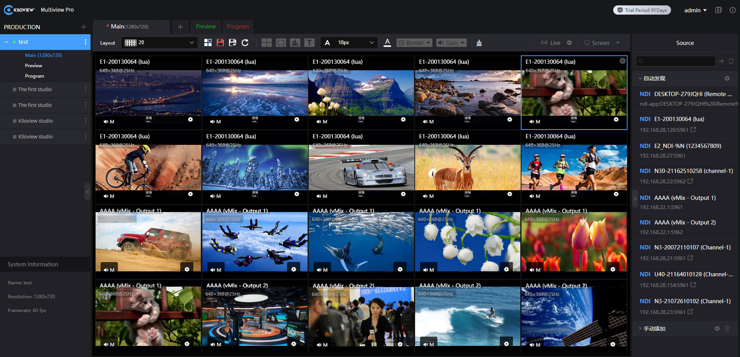
Multiview Pro
Quick Start Guide V2.2
KILOVIEW Electronics Co., Ltd.

Slide 2
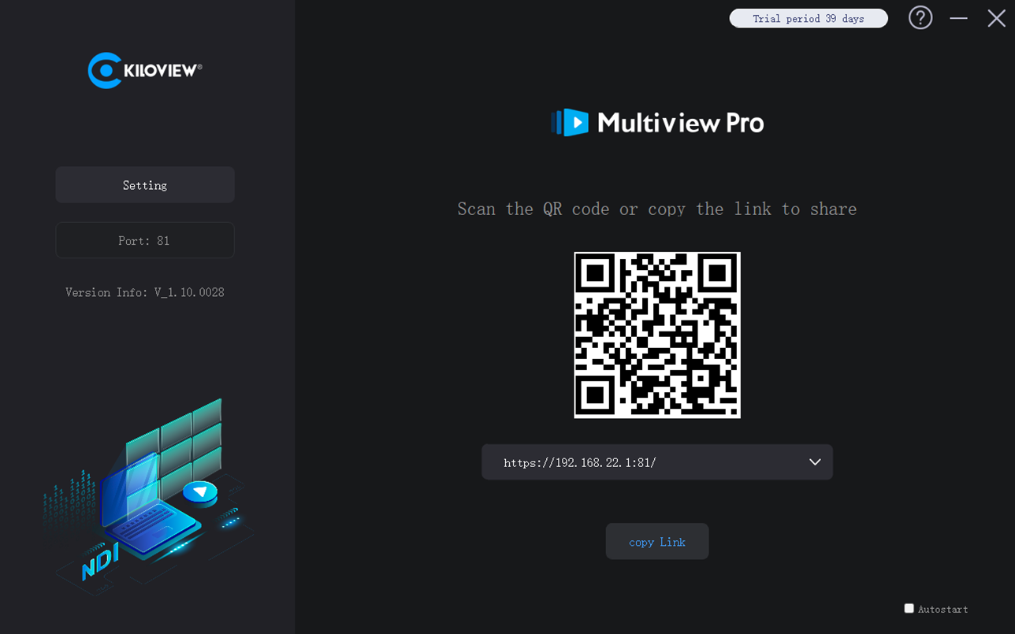
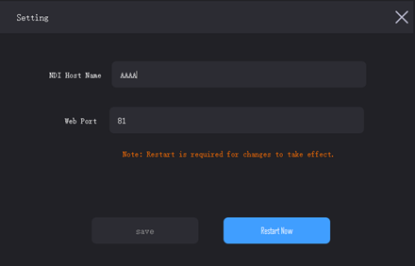
Open Muitiview Pro and click“Copy link” to copy the address to paste or print it on your web browser, or use mobile devices (Tablet, iPad), scan the QR code, and log in Multiview Pro. Default user name and password: admin/admin.
In the "Setting", you can revise the Hostname and port of NDI.
KILOVIEW Electronics Co., Ltd.

Slide 3
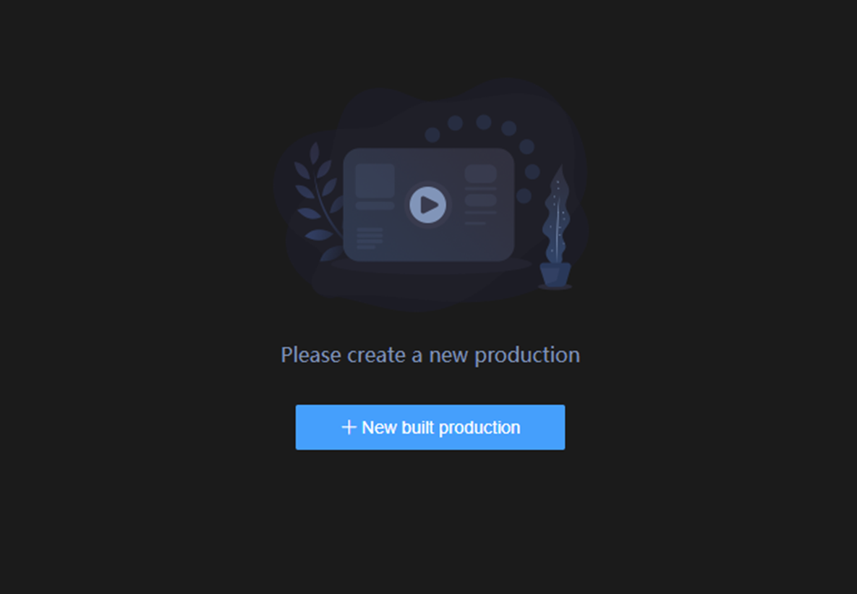
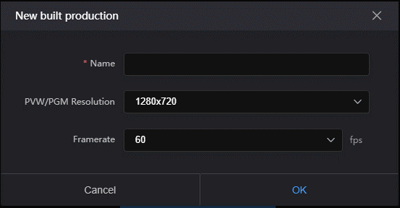
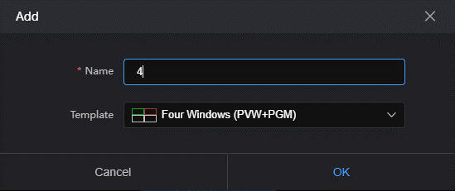
After logging into the Webpage, you need to build a production. The production supports resolution up to 3840x2160, and customized resolution is available.
When the production is completed, you can add the layout. The interface displays several common split screen modes by default. You can choose and switch up to 20 split-screens.
KILOVIEW Electronics Co., Ltd.

Slide 4
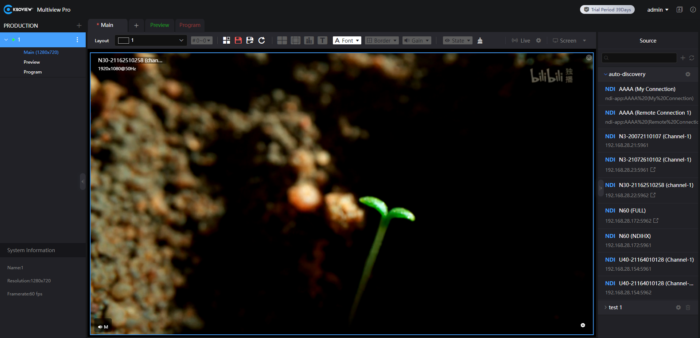
Video Source name, resolution and other information
After discovering the video source, drag the source into the layout window for preview.
Video source list-Automatic discovery of NDI sources within the same LAN.
KILOVIEW Electronics Co., Ltd.

Slide 5
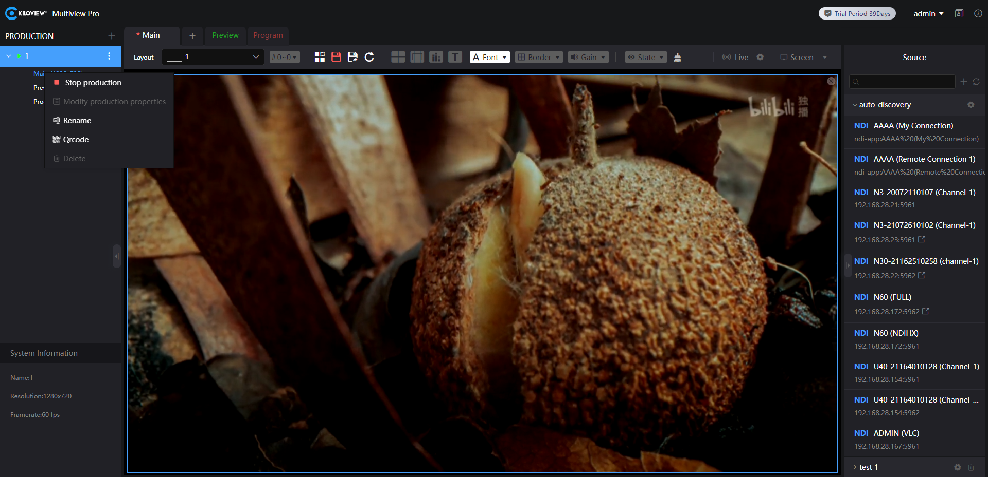
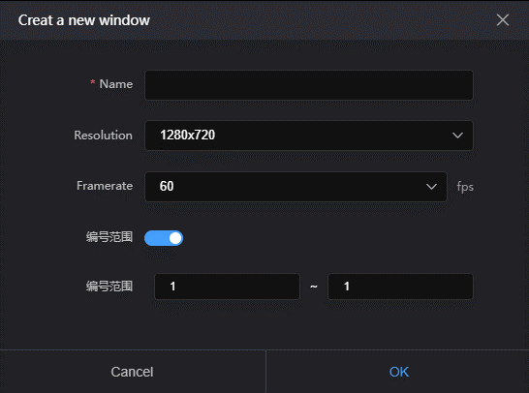
Add a new production, you can have customizable name, resolution and frame rate for PVW and PGM.
Add a window, you can set a self-defined name, numbering range and frame rate.
Modify the properties of the current production, rename and other operations
KILOVIEW Electronics Co., Ltd.

Slide 6
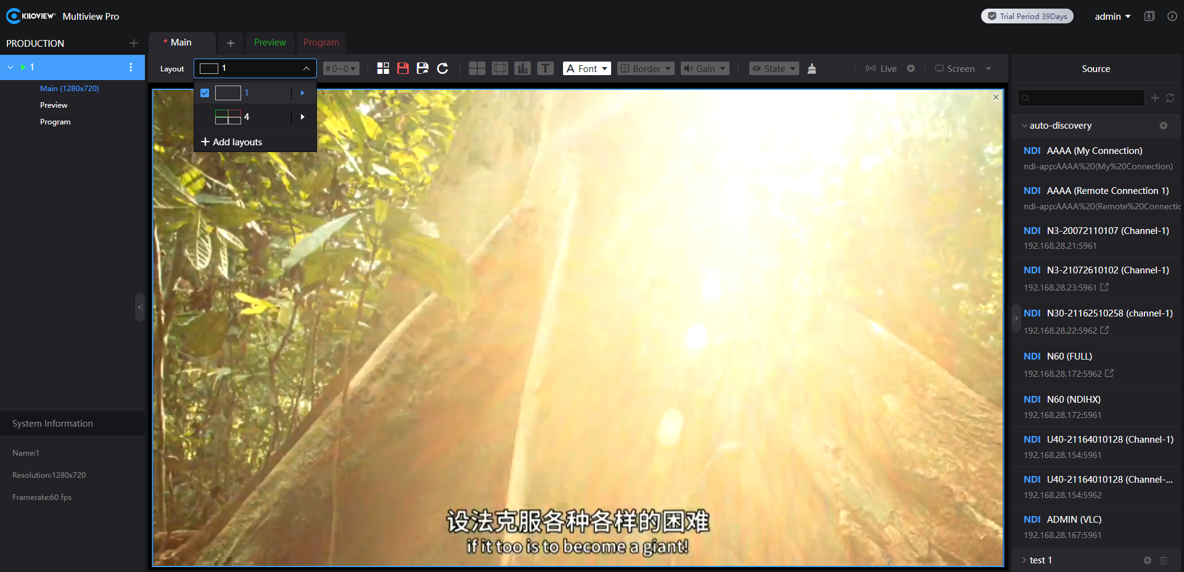
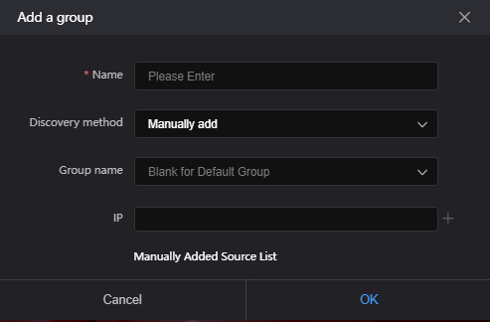
After adding a new layout, you can use the desired layout in the list.
Show the currently added NDI source groups. The default source list exists via auto discovery. Users can add new NDI source groups according to their work requirements via manual addition.
KILOVIEW Electronics Co., Ltd.

Slide 7
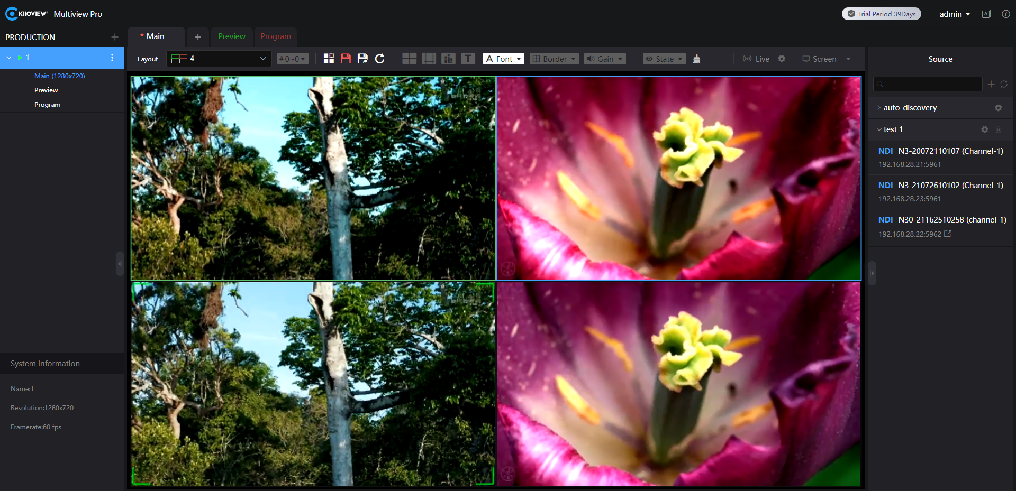










Toolbar parameter description
Icon | Illustrate
 | Switch language
 | Edit the layout, save the current layout
 | Enable and disable the display of the center cross
 | Enable or disable the safe area
 | Enable and disable volume meter
 | Enable and disable display names
 | Enable to set the size and color of the name font
 | Enable and disable all sources border overlay and set border color
 | Enable and disable audio gain for all video sources and set audio gain parameters
 | Enable or disable the display of channel information and resolution information of the NDI source
 | Clean up everything in the current layout
 | Enable and disable NDI output for the current layout
 | Enable multi-screen switch on the computer, you can switch the content of the home screen to any split screen
KILOVIEW Electronics Co., Ltd.

Slide 8
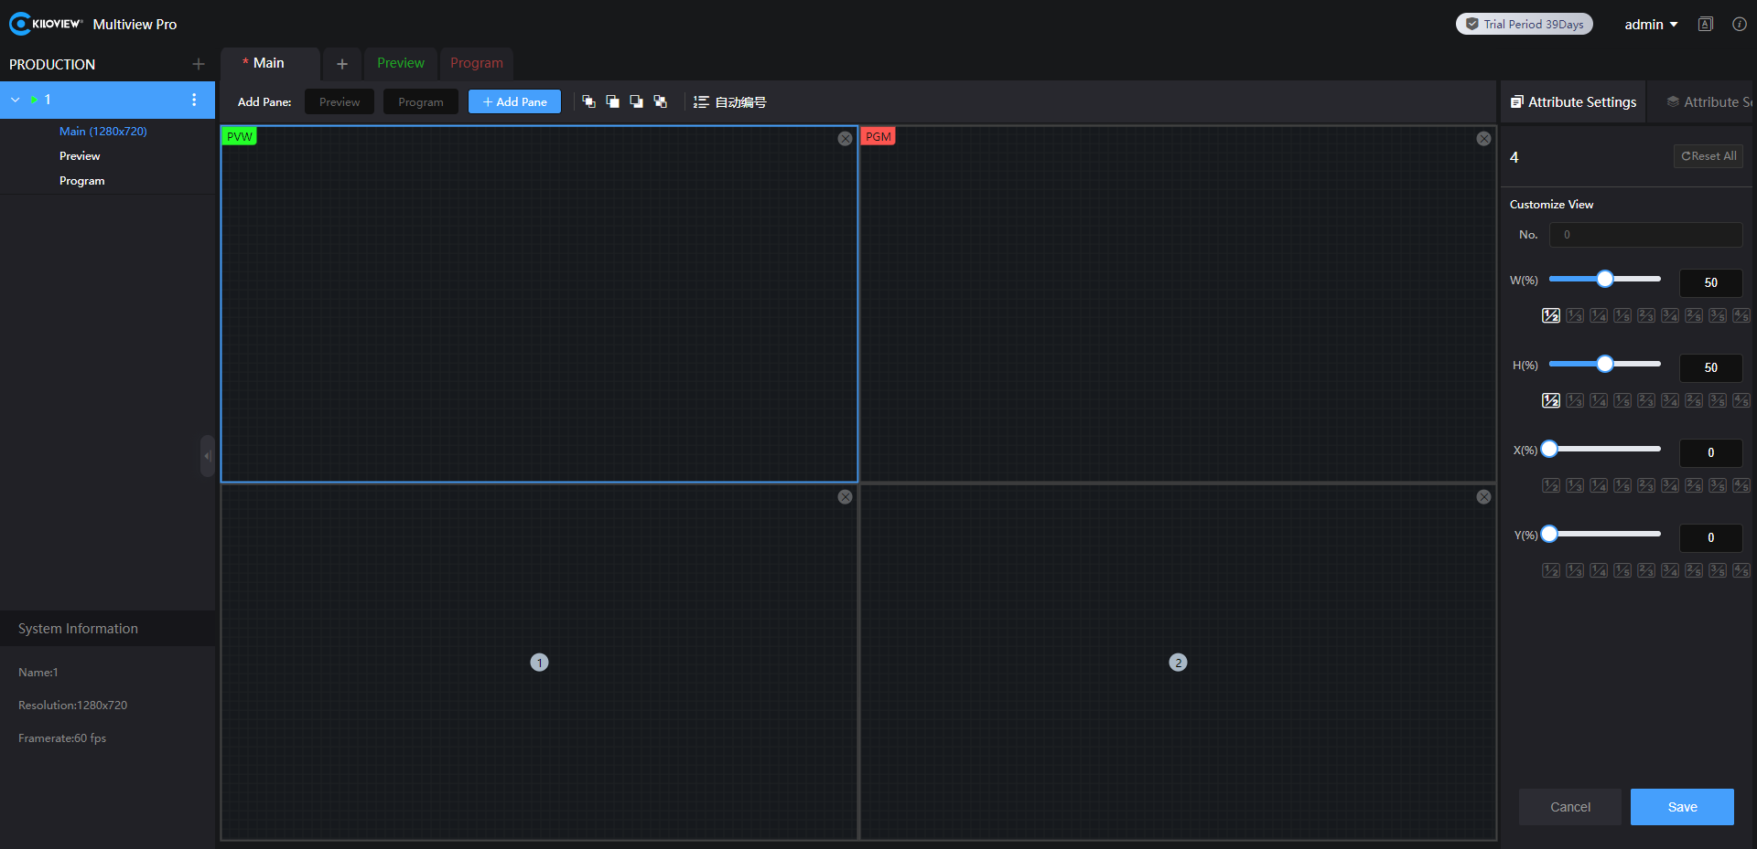
After clicking the layout editing, you can enter the layout to customize adding, deleting and adjusting the layout according to your needs. It supports layer handling of multiple panes such as layer topping, layer moving up, etc.
The size and position of the modules in the layout can be set by a click to stretch or the "width-W", "height-H", "horizontal-X" and "vertical-Y" on the right corner.
KILOVIEW Electronics Co., Ltd.

Slide 9

The image in the green frame is the PVW signal.
The image in the red frame is the PGM signal.
Click PVW/PGM to go to full screen to monitor the current PVW/PGM signal video.
KILOVIEW Electronics Co., Ltd.

Slide 10
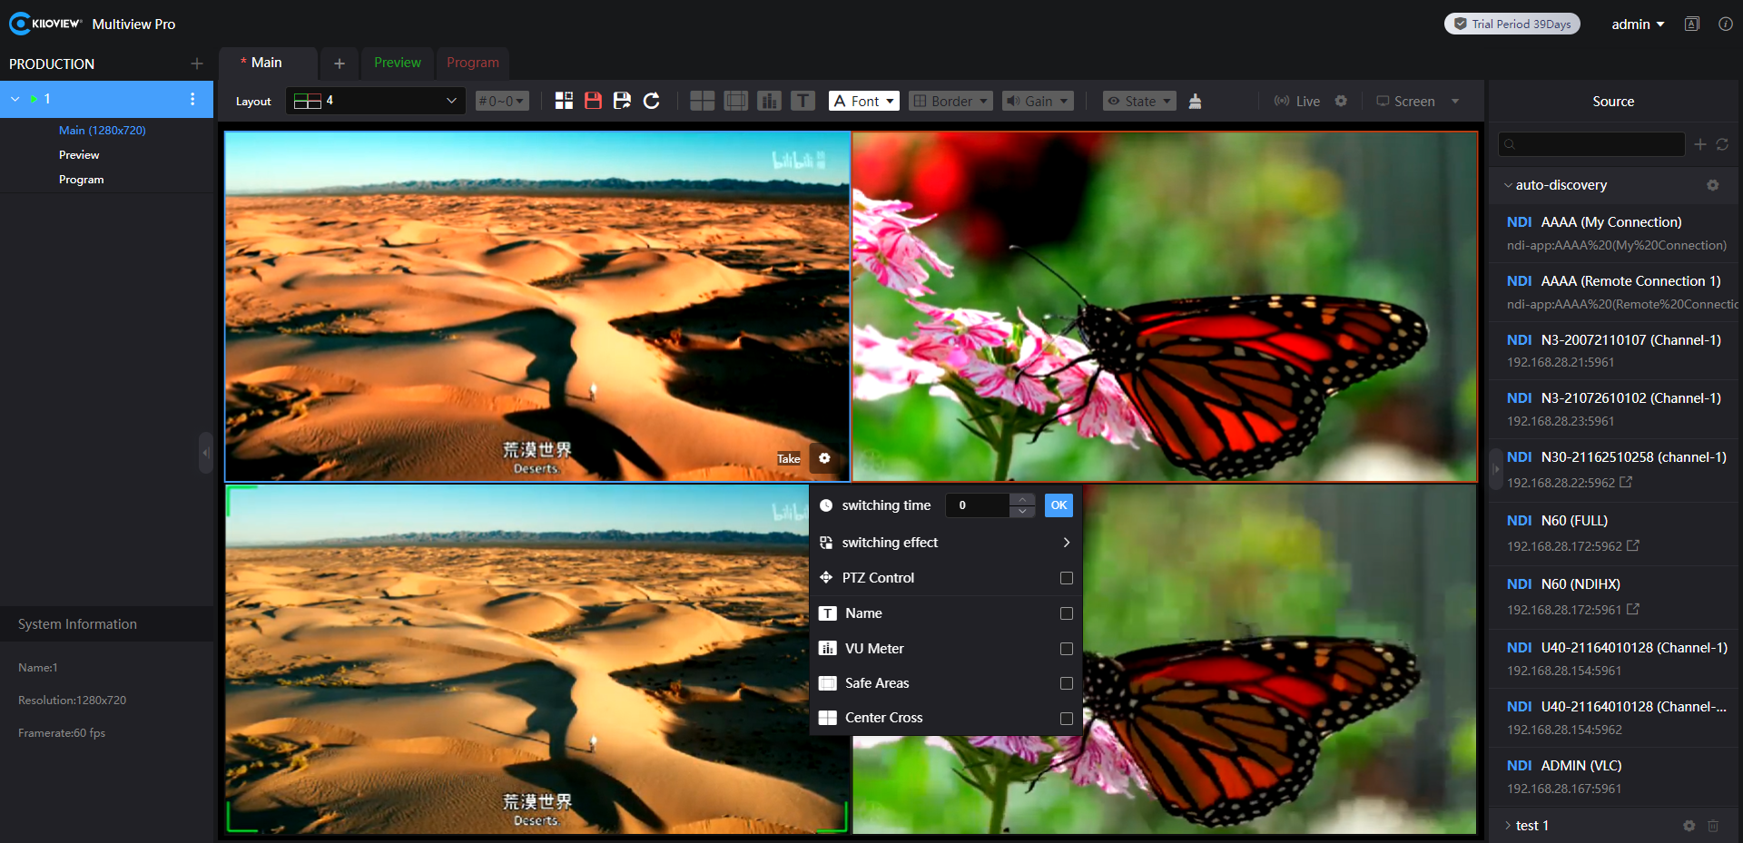
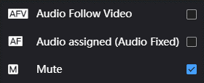

The PVW setting option supports Take switching. Click Take switching to switch the video in PVW and PGM signal. It supports setting the switching effect. It also supports editing the title name of the video source, name, volume meter, safe area, center cross and PTZ control.
The default state of the Audio Settings option is Mute (M).
Audio Assigned means that the audio is locked to the output of the PGM.
Audio Follow Video(AFV) means that the audio follows the video.
KILOVIEW Electronics Co., Ltd.

Slide 11

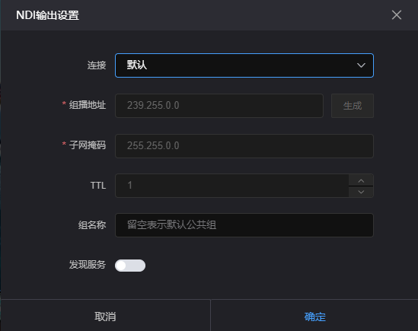
Turn on live streaming on the "Main" page, which means the current page image content will be used as NDI live output. If you need to modify the resolution and framerate of NDI output, you need to modify the " Main " window properties.
Clicking on the settings button of the live broadcast, you can set for NDI connection, multicast mode for connection, NDI group, and NDI discovery server.
Modify the window properties of “Main”
KILOVIEW Electronics Co., Ltd.

Slide 12
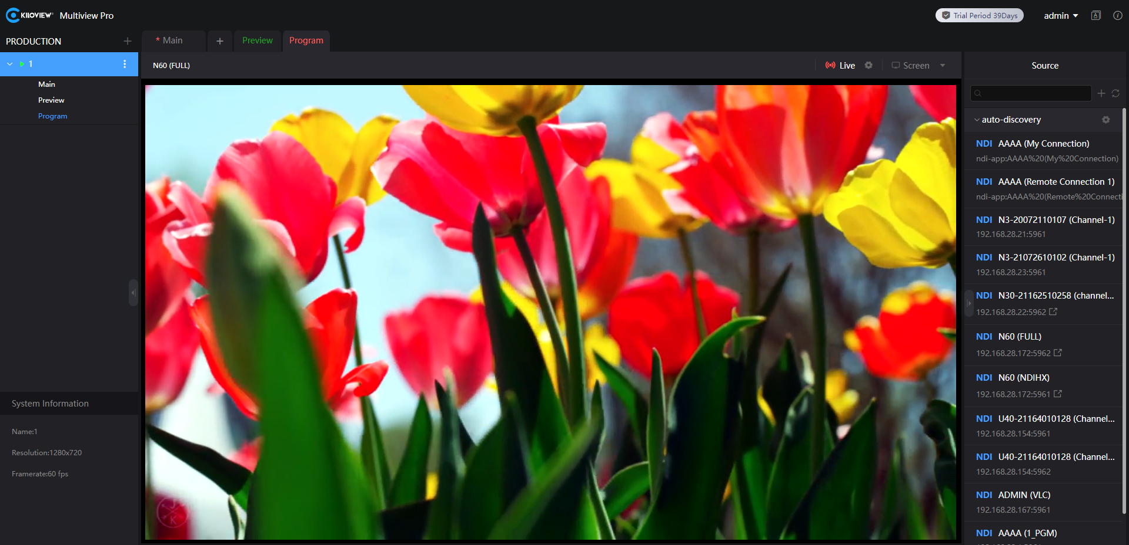
Modify the window properties of the “PRODUCTION”
Turning on the live broadcast on the PVW/PGM page means that the image content of the current page will be output through NDI live broadcast. It support video switching between PVW and PGM through the Take function.
If you need to modify the resolution and framerate of NDI output, you need to modify the current production properties. Before modifying the production properties, you need to stop the production first, and then modify it.
KILOVIEW Electronics Co., Ltd.

Slide 13
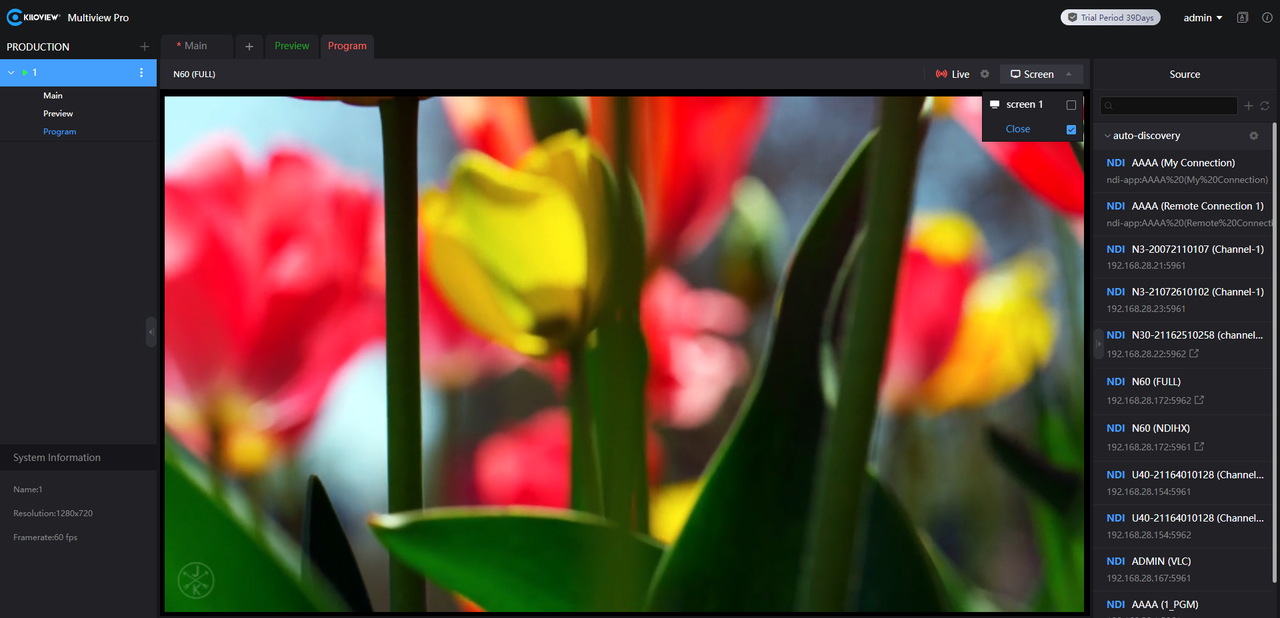
Configure by “window” and you can send the current video preview screen to the corresponding screens for display, and just one key to make the corresponding monitor window shown in full screen.
KILOVIEW Electronics Co., Ltd.

Slide 14
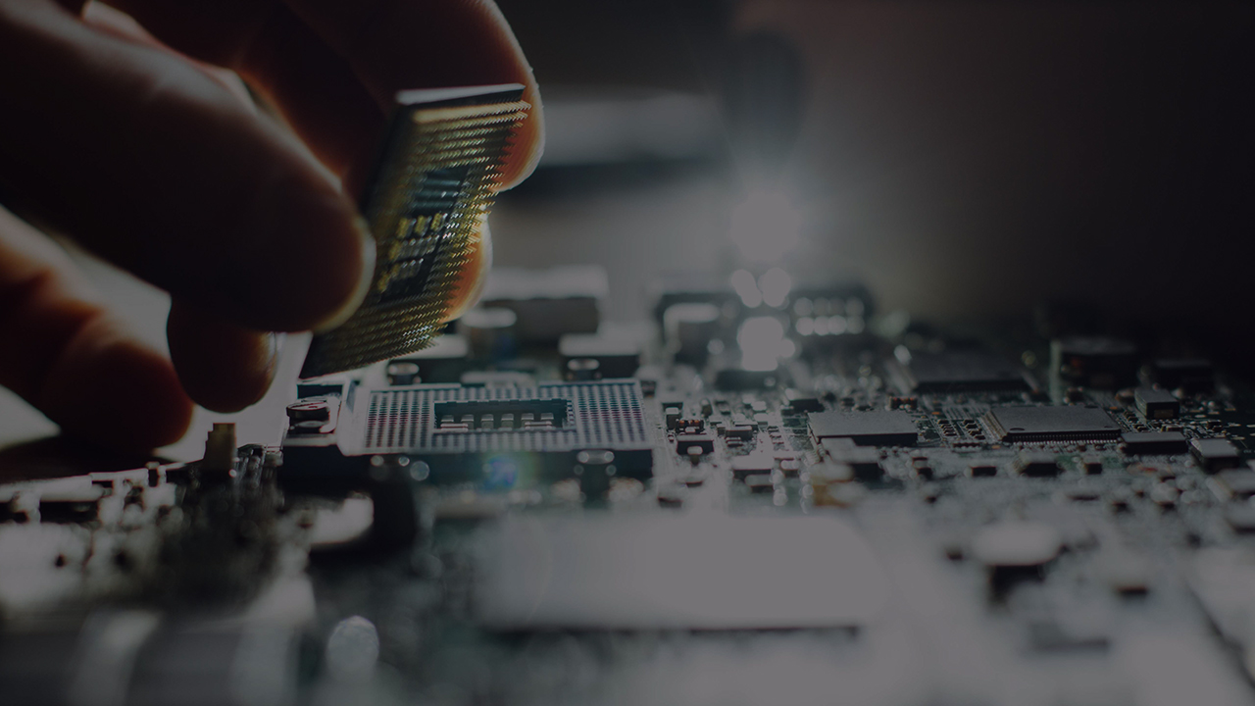


Any In Any Out Anywhere
KILOVIEW Electronics Co., Ltd.
Tel：86-731-88315979 E：info@kiloview.com Support：support@kiloview.com
Add: B4-106/109, Jiahua Intelligence Valley Industrial Park, 877 Huijin Road, Yuhua District, Changsha, China

